Slide 1
Audio Classification on Urban Sounds
Aayush Singh (G26487644)

Slide 2
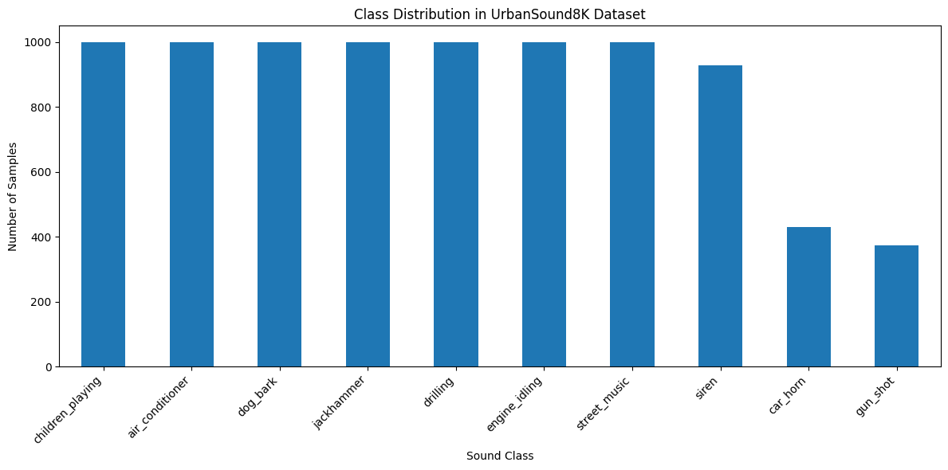
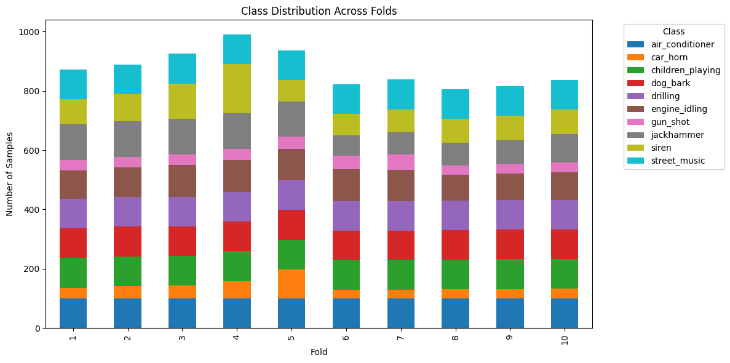
Overview
Goal: Compare and evaluate a range of machine learning and deep learning models for audio classification on the UrbanSound8K dataset.
Dataset: UrbanSound8K
8,732 labeled audio clips (≤4 sec, 10 classes).
Audio clips are real-world recordings with significant environmental noise.
Organized into 10 predefined folds for 10-fold cross-validation. I adhered strictly to this evaluation strategy —training on 9 folds and testing on 1— to prevent data leakage and so the results are comparable to previous research

Slide 3
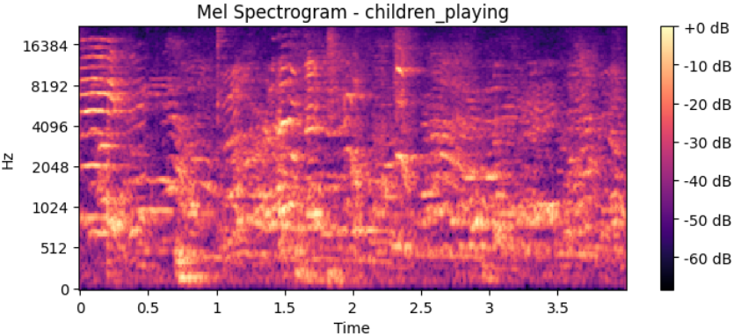
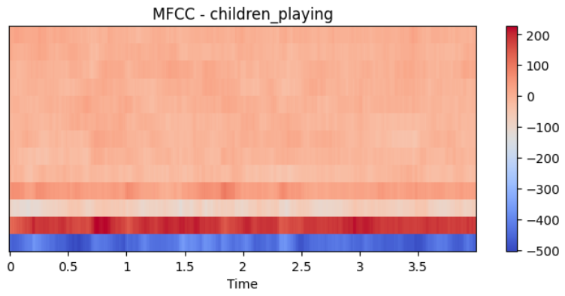
Preprocessing
Data Augmentation Techniques
Applied to introduce robustness and improve generalization
Time stretching
Pitch shifting
Background noise injection
Feature Extraction
The choice of features was driven by the model architecture
1. Statistical Features
Models: Random Forest, SVC, KNN, Simple ANN
Input: MFCC Statistics - Aggregation of the MFCC matrix into a fixed-length vector by calculating the mean, standard deviation, min, max of each coefficient across time.
2. Spectral Features
Models: 2D CNN, EfficientNet-B0, Audio Spectrogram Transformer
Input: Mel Spectrograms - Visual representations (spectrograms) showing frequency intensity over time

Slide 4
Initial Experiments
Model | Input Features | Accuracy | Precision | Recall | F1 Score | MCC | ROC AUC
KNN | MFCC Stats | 55.99% | 57.99% | 55.99% | 54.81% | 0.5123 | 0.8148
Random Forest | MFCC Stats | 67.85% | 69.26% | 67.85% | 67.00% | 0.6425 | 0.9375
ANN | MFCC Stats | 68.87% | 68.73% | 68.87% | 67.81% | 0.6533 | 0.9405
SVC | MFCC Stats | 69.59% | 69.65% | 69.59% | 68.64% | 0.6612 | 0.9412
2D CNN | Mel Spectrogram | 74.64% | 76.98% | 74.64% | 74.01% | 0.7200 | 0.9558
Traditional ML models struggled because MFCC statistics lose almost all temporal structure. Treating audio as a fixed-length feature vector oversimplified the problem.
2D CNN achieved the best performance because:
Mel spectrograms preserve rich time–frequency patterns
CNNs interpret them like images, learning spatial patterns that MFCCs cannot capture

Slide 5
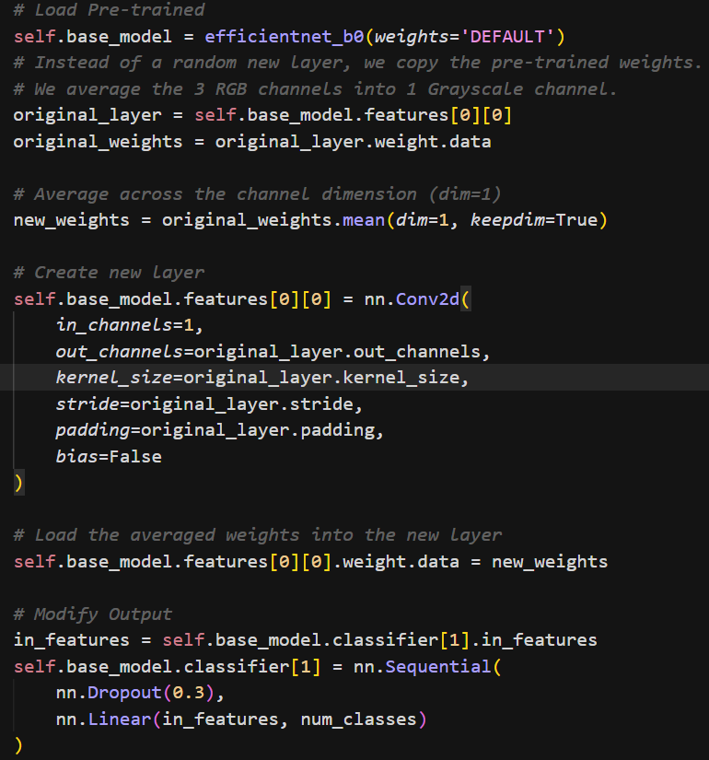
Transfer Learning - 1
EfficientNet
Leveraged EfficientNet-B0, a CNN architecture known for high efficiency, pre-trained on ImageNet (a massive dataset of 14M+ images like animals, vehicles, and objects).
Adapted the model from 3-channel (RGB) to 1-channel (Audio) by averaging pre-trained weights, preserving learned feature detectors instead of starting from scratch .
MixUp Augmentation: Implemented MixUp during training, which blends pairs of audio inputs and labels to prevent overfitting and smooth decision boundaries.
Example: Instead of training on a single "Dog Bark," the model learns a hybrid: 0.7 * “Dog Bark” + 0.3* “Siren”

Slide 6
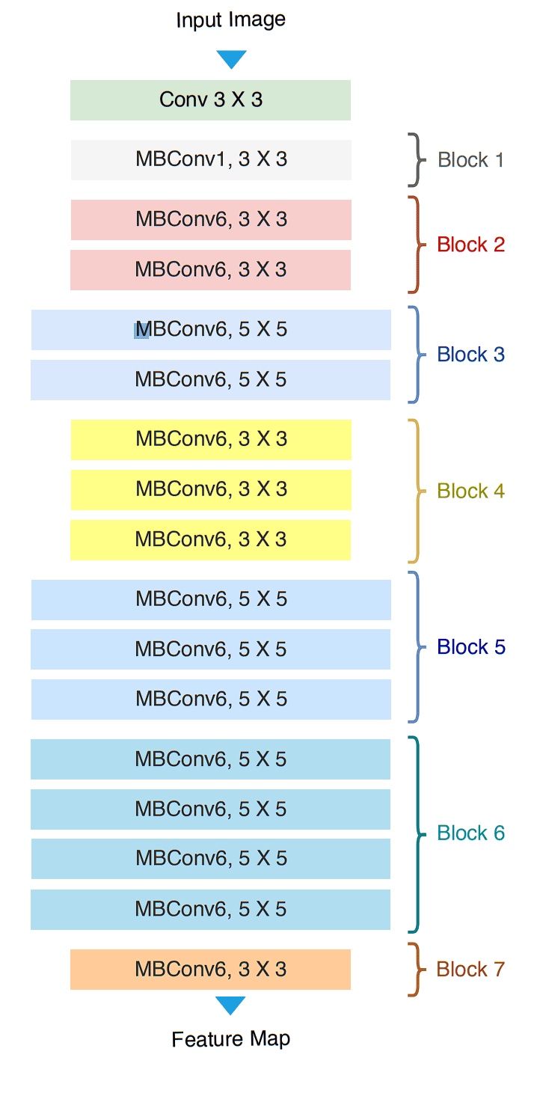
Architecture of EfficientNet

Slide 7
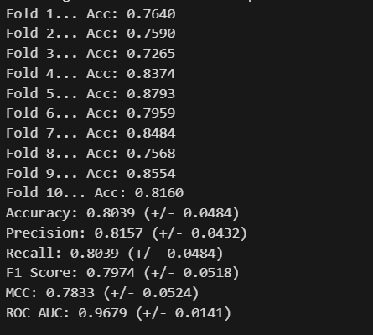
Results
Metric | Score
Accuracy | 80.39%
Precision | 81.57%
Recall | 80.39%
F1 Score | 79.74%
MCC (Matthews Corr. Coef.) | 0.7833
ROC AUC | 0.9679

Slide 8
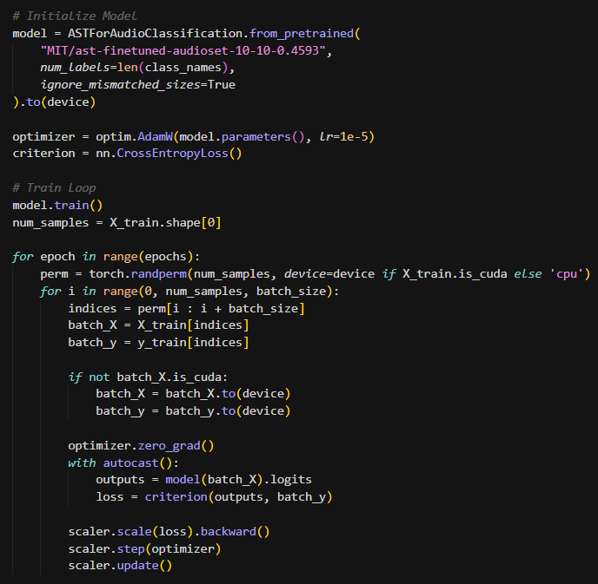
Transfer Learning - 2
Audio Spectrogram Transformer
Implemented the AST model, applying Transformer architecture
(Self-Attention) to audio, enabling the model to capture global dependencies across the entire clip time-frame .
Implementation & Transfer
Source: Initialized with weights pre-trained on AudioSet (MIT/ast-finetuned-audioset), utilizing knowledge from ~2 million general audio clips.
Resampling and Padding: Converted all audio to 16kHz to match the frequency expected by the pre-trained AudioSet weights.
Head Replacement: Replaced the final classification layer (originally 527 outputs) with a new, randomly initialized Dense layer for our 10 UrbanSound8K classes .
Input Processing: Converted spectrograms into a sequence of 1,024 patches for the Transformer to analyze.

Slide 9
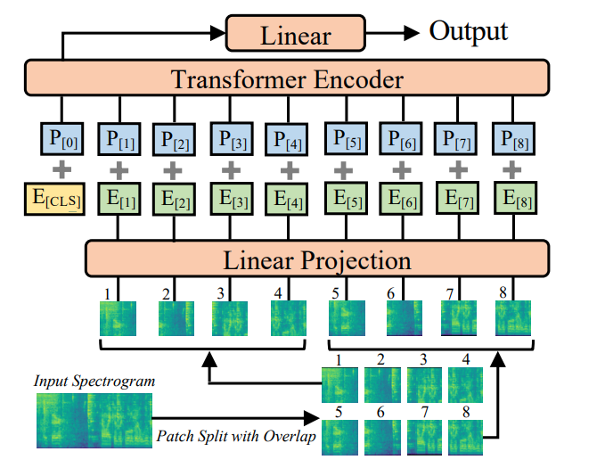
Architecture of Audio Spectrogram Transformer

Slide 10
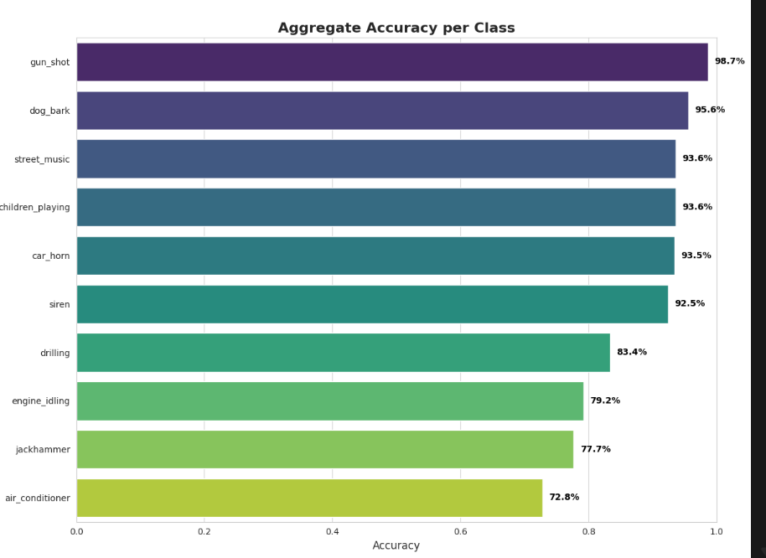
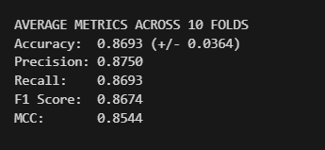
Results
Final Accuracy across 10 folds: 86.93%

Slide 11
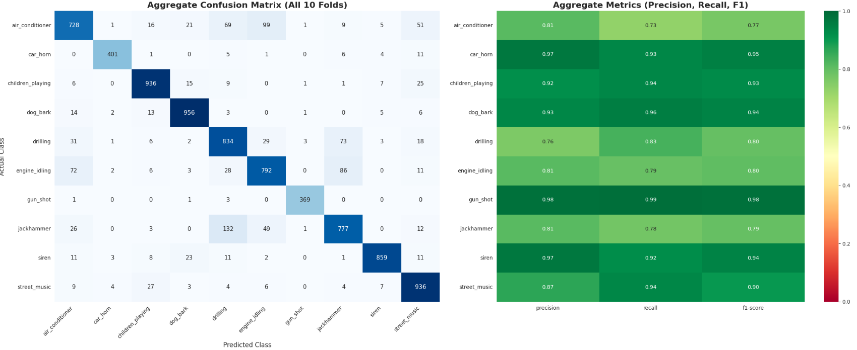
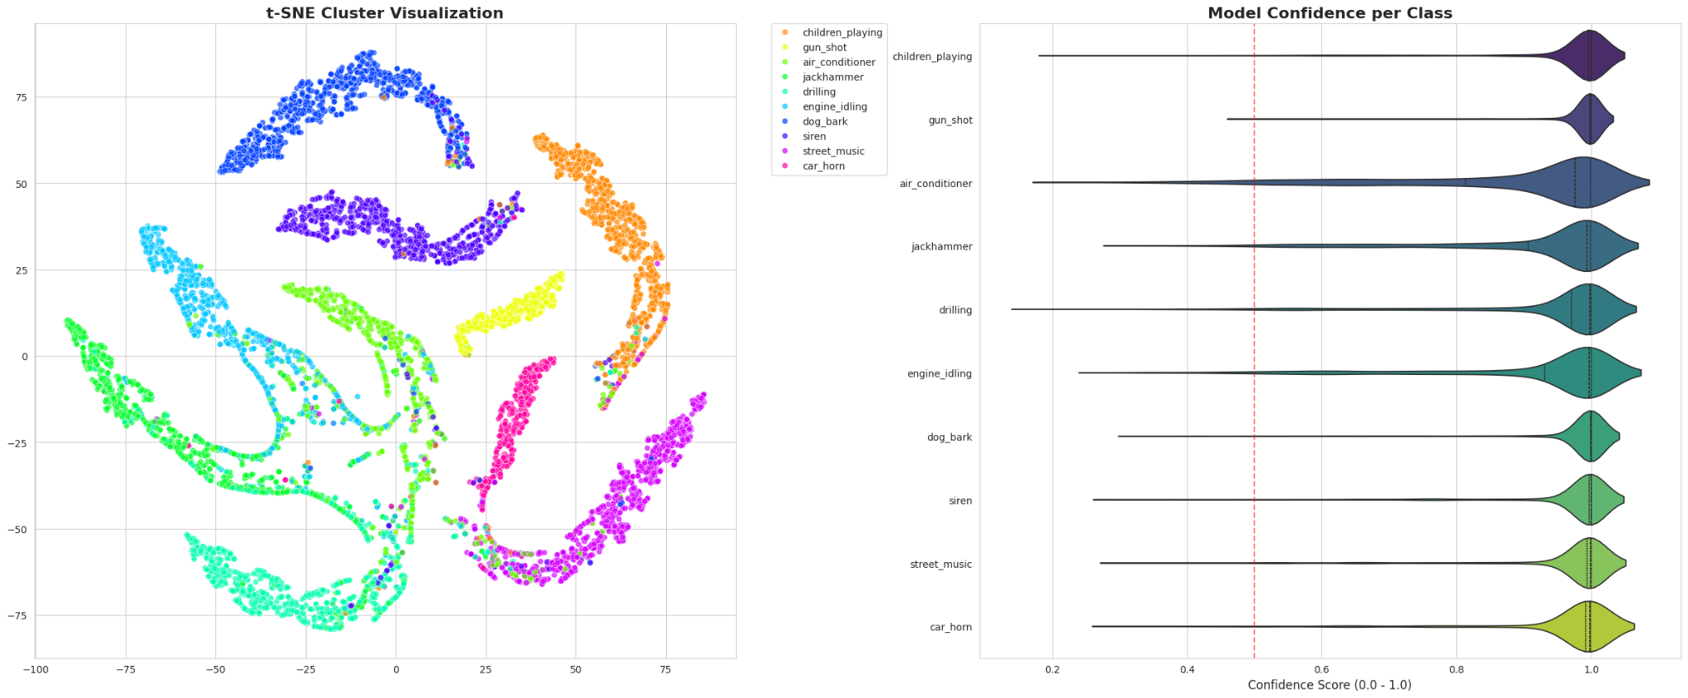
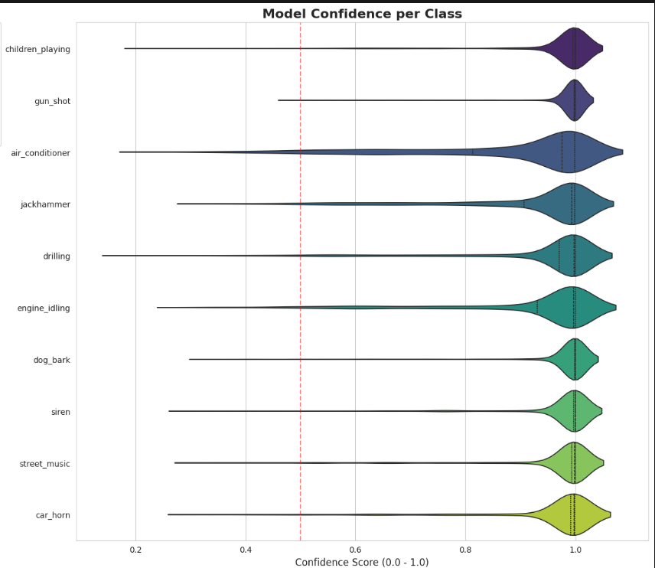
Results

Slide 12
Benchmarks & Related Research
When compared to published research that adheres to the Official 10-Fold Cross-Validation protocol, this AST implementation successfully outperforms sophisticated CNN architectures from 2017–2020, such as EnvNet-v2 and ESResNet
Model / Paper | Year | Architecture | Accuracy
Piczak | 2015 | 2-Layer CNN | 73.10%
Salamon & Bello (SB-CNN) | 2017 | Deep CNN | 79.00%
EnvNet-v2 (Tokozume et al.) | 2017 | End-to-End CNN | 84.90%
ESResNet (Guzhov et al.) | 2020 | ResNet-50 (Attention) | 85.40%
My AST Implementation | 2025 | AST (Transformer) | 86.93%
End-to-End Audio Pattern Net | 2024 | Dual-branch Architecture | 90.91%
Patch-Mix Transformer (Chen et al.) | 2024 | Transformer + Contrastive | 92.95%

Slide 13
Thank you!

